Slide 1
Data analytics and supply chain for fisheries

Slide 2
ABSTRACT :-
Without proper statistics or adequate analyzation of our progress there is no scope for improvement or success in any field. Hence, I propose a project to analyze the pre-existing data of fishermen and provide statistical overview of finance and work. My simple plan is to store data of fishermen (Expenses, types of fish, present market rate, future prediction) into a database and provide statistical output which does help the fishermen improve their profits.

Slide 3
Introduction :-
A supply chain is a network of entities or activities through which goods and services are produced and distributed from suppliers to users (industries or final users). Studies often use input-output (IO) models to analyze the supply chain of industries within a sub-national region or a country or across the world. IO models are suitable for an analysis of the supply chain because of their capability to scrutinize the transactions among the industries within an economy.

Slide 4
Introduction :-
Industries are dependent on each other by purchasing and selling intermediate goods from and to the other industries. For instance, in order to process raw fish in the seafood processing industry, the industry purchases fuel from the petroleum refining industry and services from the finance and insurance industry. Once the raw fish is processed, the processed seafood is supplied to other industries, such as the food service industry or to households for final consumption.

Slide 5
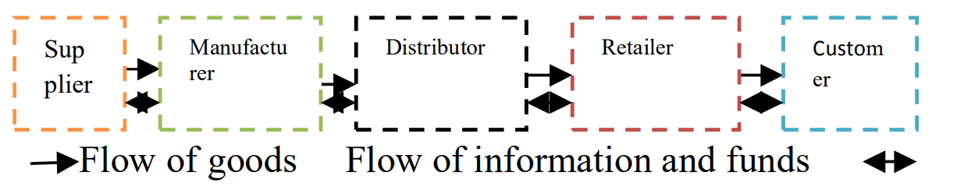
Supply Chain for fisheries

Slide 6
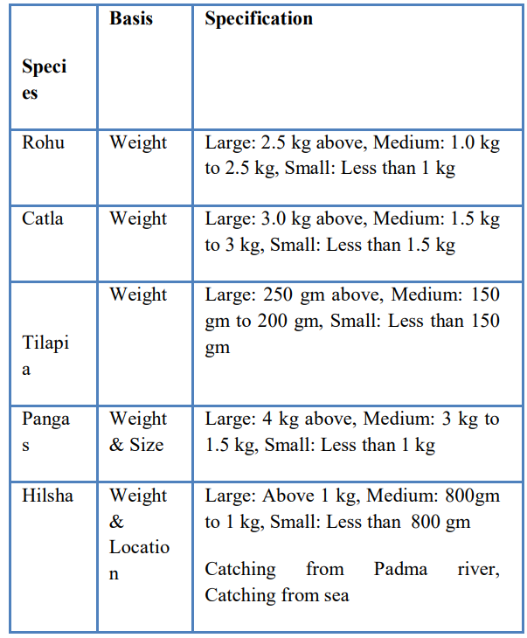
Fish categories and Types

Slide 7
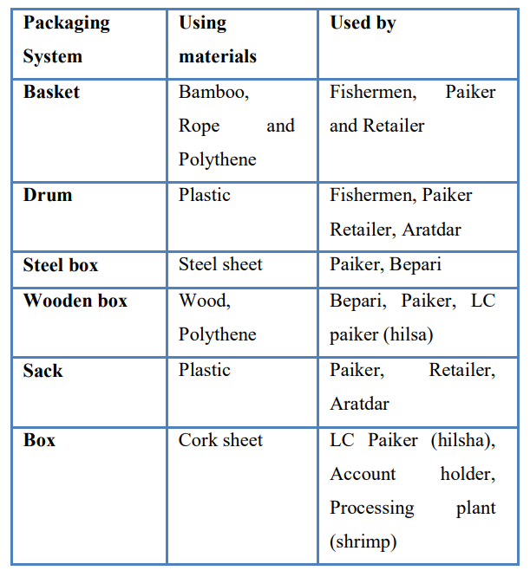
Catching the fish is not the only work for fishermen, he needs to deal and organize with many other things to complete the whole supply chain.

Slide 8
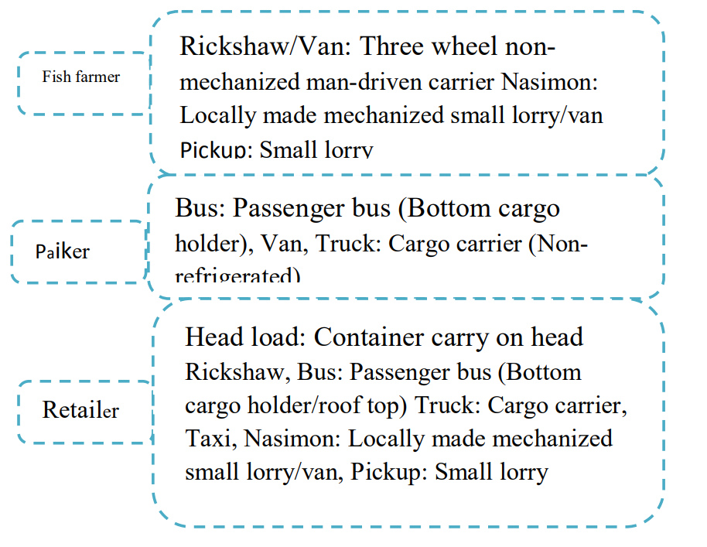

Slide 9
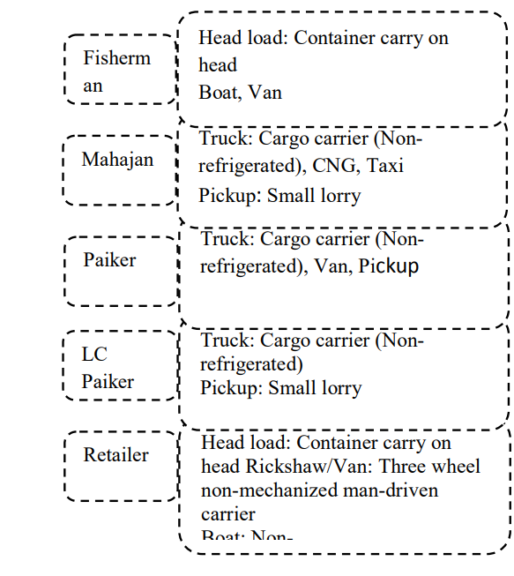
The complete flow chat of fishery

Slide 10
System Requirements
Hardware Requirements
Processor : Any Processor above 500 MHz.
Ram : 4 GB
Hard Disk : 4 GB
Input device : Standard Keyboard and Mouse.
Output device : HDMI and High Resolution Monitor.
Software Requirements
Operating System : Windows 7 or higher
Programming: Python 3.6, R, Sql and related libraries

Slide 11
Applications :-
Risk Management
Interaction with customers
Risk detection
Computerized Shipping and Tracking

Slide 12
References :-
1. Supply Chain Management in Fishing Industry
Sanjida Binte Islam* , Dr. Md. Mamun Habib
2. Examining Supply Chain for Seafood Industries Using Structural Path Analysis
Chang K. Seung 1 and Do-Hoon Kim 2

